Slide 1
Mantid Current Development and other news
Nicholas Draper
Scientific Steering Committee 2015

Slide 2
Agenda – Tuesday am
9:30 | Garden Room Welcome (Robert McGreevy) Meeting objectives (Toby Perring) Scientific direction & drivers from ORNL (Garrett Granroth) Scientific direction & drivers from ISIS (Ross Stewart) Review of Progress on previous SSC requirements (Nick Draper)
11:00 | Science Group breakouts (Coffee available in rooms) Mantid Current and future usage requirements The Quiet Room Diffraction inc Powder, PDF, Disordered and Engineering (M. Gigg, R. Whitfield) The Cottage Room Inelastic scattering Inc Direct indirect (R. Stewart, S. Campbell) The Bar area SANS (A. Markvardsen, P. Peterson) The Thames Room Reflectometry (G. Granroth, O. Arnold)
12:00 | Garden Room Group Photo
12:10 | Restaurant Lunch

Slide 3
Agenda – Tuesday pm
13:00 | Continue in breakout rooms Groups generate priority list of medium / long term requirements
15:00 | Break
15:30 | Restaurant Roadshow - Drop in demonstration and discussion sessions for VATES - multi dimensional visualization and analysis (Owen) Fitting (Roman) Plotting (Owen) Scripting, iPython & extending Mantid (Martyn) Technique specific reduction Single Crystal (Pascal) Direct Inelastic (Jon Taylor) Direct Inelastic (Russell Ewings) LiveData (Stuart) Autoreduction (Anders / Pete)
17:00 | Close

Slide 4
Agenda – Wednesday am
09:00 | Garden Room Group presentations and discussion
10:00 | Garden Room General requirements (Nick Draper) Mantid Current and future usage requirements to cover Website / Documentation Training Plotting & graphing Vates
12:00 | Restaurant Lunch

Slide 5
Agenda – Wednesday am
13:00 | Garden Room General requirements (Nick Draper) Mantid Current and future usage requirements to cover Fitting Remote Access Usage Tracking
15:30 | Break
16:00 | Mantid plans at other Facilities ILL - Mark Johnson ESS - Jon Taylor
16:30 | AOB & feedback
17:00 | Close

Slide 6
Releases
Complete releases since last SSC
v3.1 7th Feb 2014
v3.1.1 28th Feb 2014
v3.2 14th July 2014
V3.2.1 28th August 2014
v3.3 19th January 2015

Slide 7
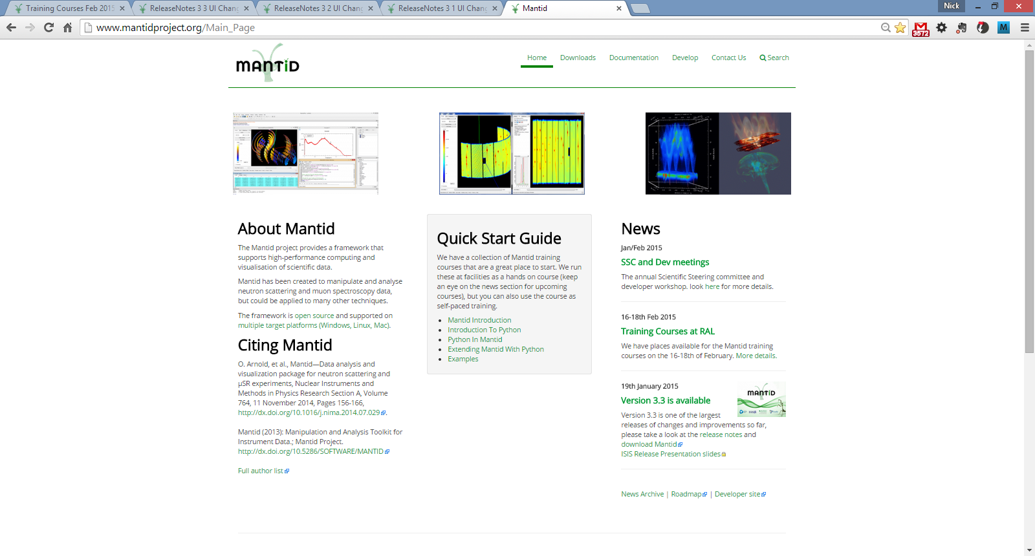
Roadmap

Slide 8
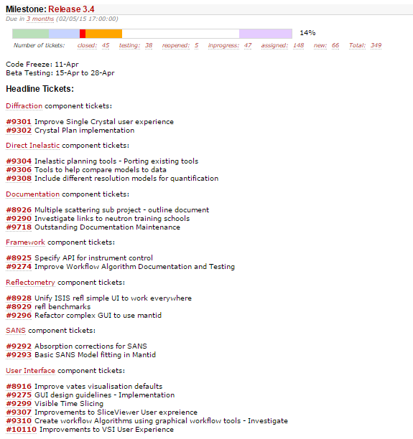
Roadmap

Slide 9







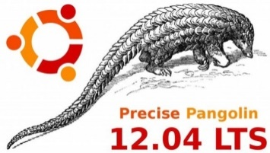
Supported Platforms
Staying the same
RHEL 6 64bit
OSX Mountain Lion +
Windows 7 64 bit
Ubuntu 14.04 64 bit
Limited support for
Windows 8 64 bit
Fedora 20
RHEL 7 64bit
No Longer supported
Ubuntu 12.04 64 bit

Slide 10
Progress on SSC requirements
mostly framework

Slide 11
6 Month view
Items currently under development
Tiling displays
Multi data fitting
CLI (for VATES)
Planned development starting <6m
Workflow Algorithms
History depth / extracting scripts
Masking redesign(LT)
Improve GUIs
Improve Vates defaults
Documentation maintenance (ongoing)
Load performance
Plotting improvements
Repo. for instrument files
Spec API for instr. control

Slide 12
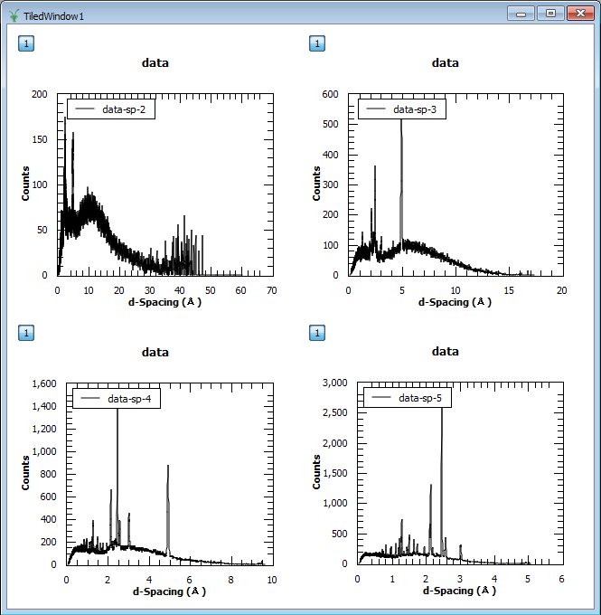
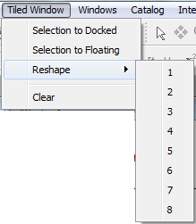
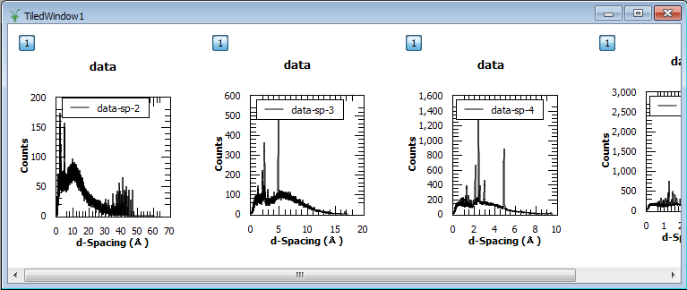
Tiled graphs
Add graphs by drag and drop
Rearrange
Select and remove
Reshape

Slide 13
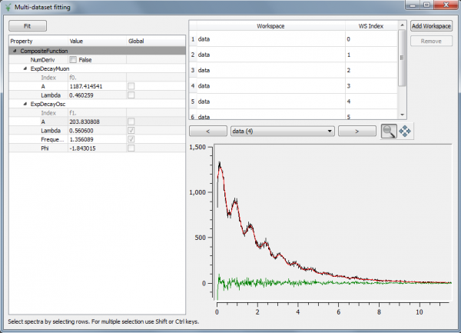
Multi-Dataset Fitting
New interface for fitting across multiple data sets
Possible before but only from scripts
Missing some features of main fitting but is fully usable

Slide 14
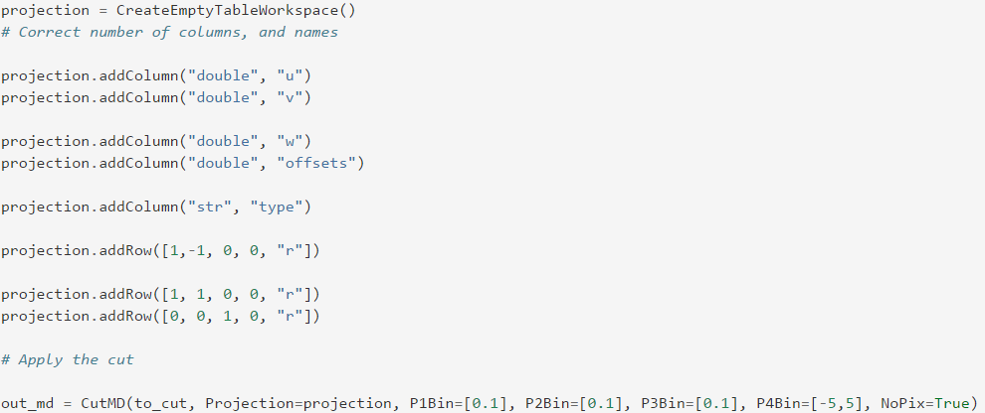
CLI (for VATES)
Cutting Syntax
Similar to Horace
Uses a projection table to define the slice
Extents calculated in new basis if not provided
Currently works for 3D and 3D data, needs extending to other cases
http://docs.mantidproject.org/nightly/algorithms/CutMD-v1.html

Slide 15
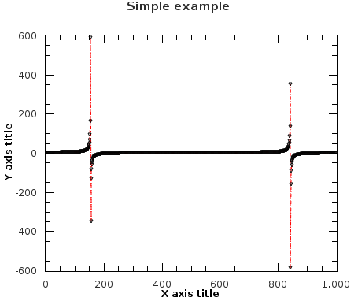
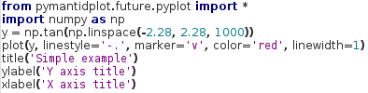
Python Command Line Interface
Experimental: from pymantidplot.future.pyplot import *
/ import pymantidplot.future.pyplot as plt
Harmonized interface:
plot(source=[{Workspace(s)}], tool={ToolName}, **kwargs)
ToolName: ‘plot_spectrum’, ‘plot_bin’, ‘plot_md’, …
Functional interface (pyplot / matlab):

Slide 16
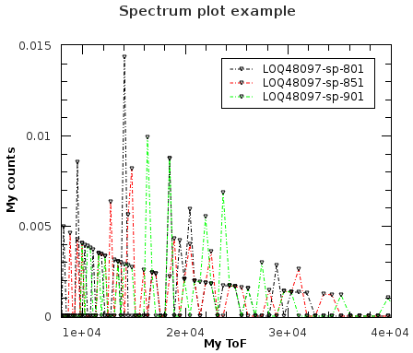
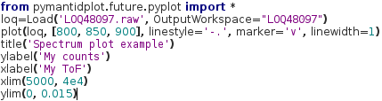
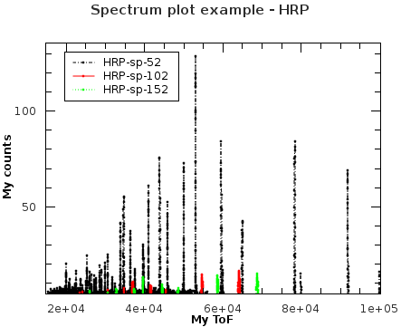
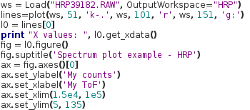
Python Command Line Interface
Plotting spectra:
Object-oriented interface (Figure, Axis, Line2D, etc.):

Slide 17
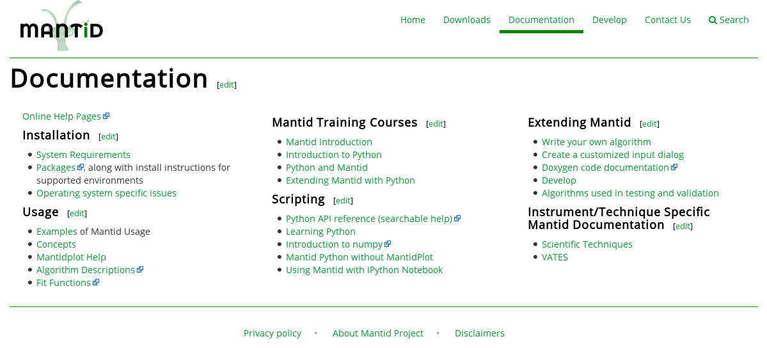
Python Command Line Interface
To learn how to use it:
help(pymantidplot.future.pyplot)
http://docs.mantidproject.org/nightly/api/python/index.html
Familiar interface, >90% like the Pyplot tutorial: http://matplotlib.org/users/pyplot_tutorial.html

Slide 18
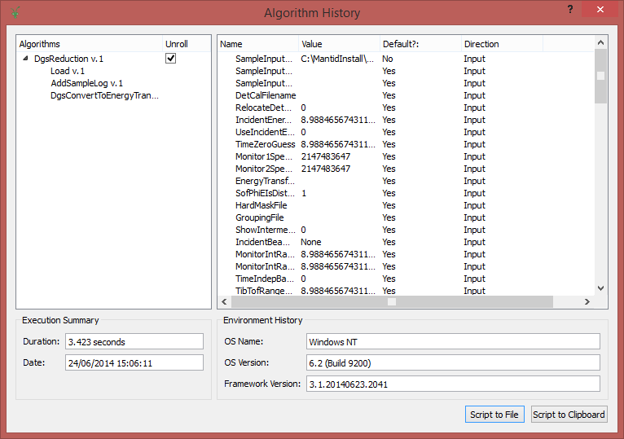
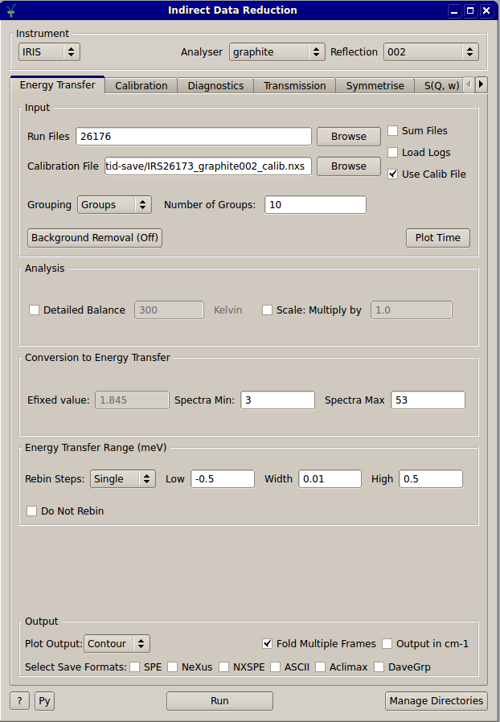
Workflow Algorithms History depth / extracting scripts
Workflow Diagrams
Nested History
Able to reveal the underlying step of Workflow Algorithms
No more black boxes
User interfaces
Output script buttons
Not universal yet

Slide 19
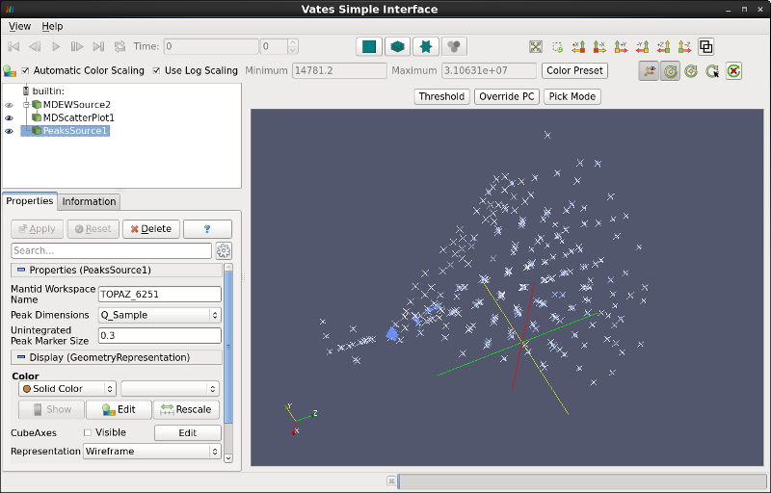
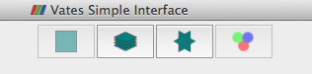
Improve Vates defaults
Technique dependent initial view in VSI
Not quite ready for release 3.3
More powerful in-situ rebinning
Better colour map boundaries and harmonization
Better default rebinning
Faster representations at lower memory overhead
Faster slicing
Multi-window mode
A less confusing interface
http://www.mantidproject.org/VatesSimpleInterface_v2

Slide 20
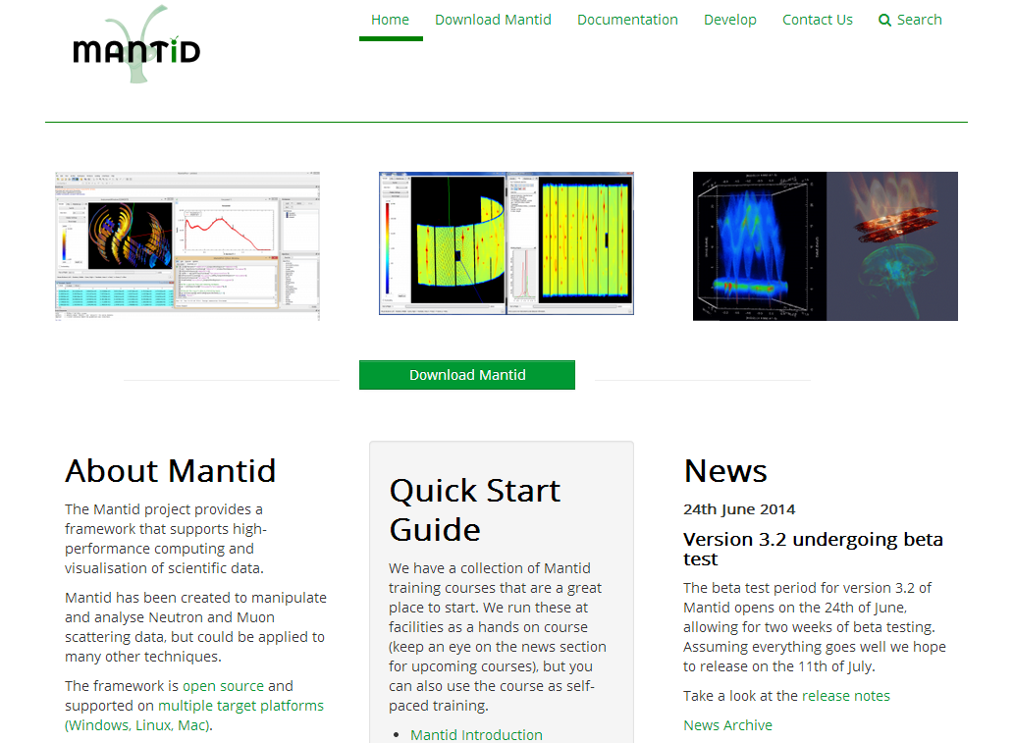
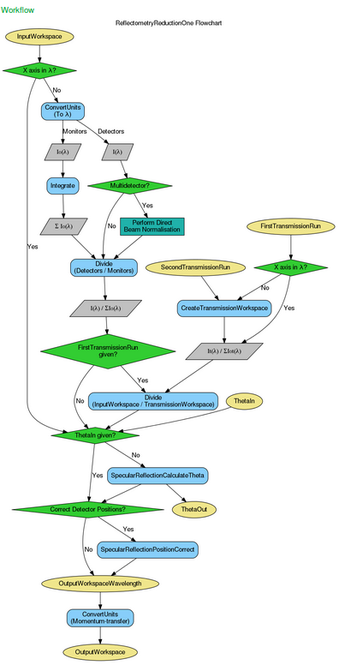
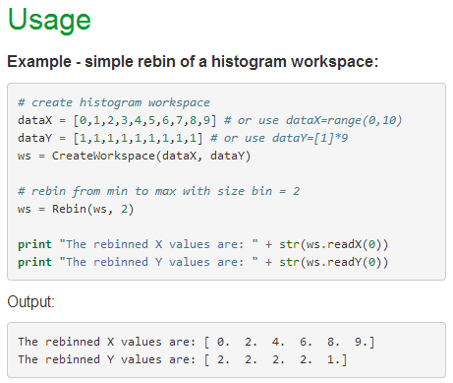
Documentation and Website
Look and feel
Redesigned Website
Stability
Moved to a cloud server
Functionality
Anyone can request accounts
Lots of outdated information removed
Algorithm & concepts
Many rewritten
Tested usage examples
Workflow Diagrams
Same information online and offline

Slide 21
Load Performance
Investigated HDF5 vs Nexus
Significant gain to be had for events
No improvement for histogram data
Significant effort to change
inst | info | with nexus (c++)/ms | with nexus (napi)/ms | with hdf5/ms
POLREF | Histogram 641 * 1000 | 47 | 49 | 49±3
MARI | Histogram 922 * 2663 | 136 | 142 | 144±5
SEQ | 253 items in NXentry | 472±4 |  | 183±6
PG3 | 74 items in NXentry | 380±10 |  | 356±2
NOM | 228 items in NXentry | 291±8 |  | 41±3
LET | 47 items in NXentry | 224±7 |  | 219±3

Slide 22
Load Performance
Speedup for Workspace Groups
For 500 workspaces: 138 s => 8 s
Long History affecting load/save speed
Performance improved
Or use RemoveWorkspaceHistory
Memory Management
Very slow deletion of large histogram workspaces on Windows.
MERLIN reduction on Windows 11mins->2mins!

Slide 23
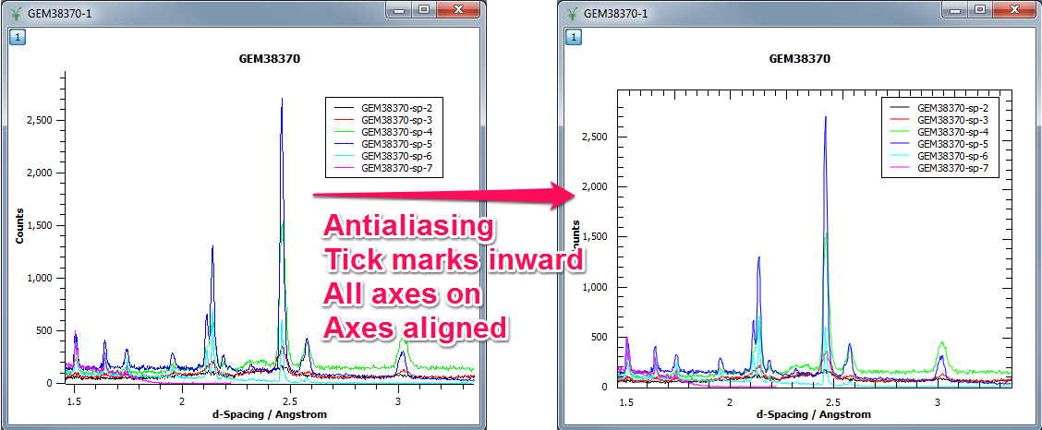
Plotting Improvements

Slide 24
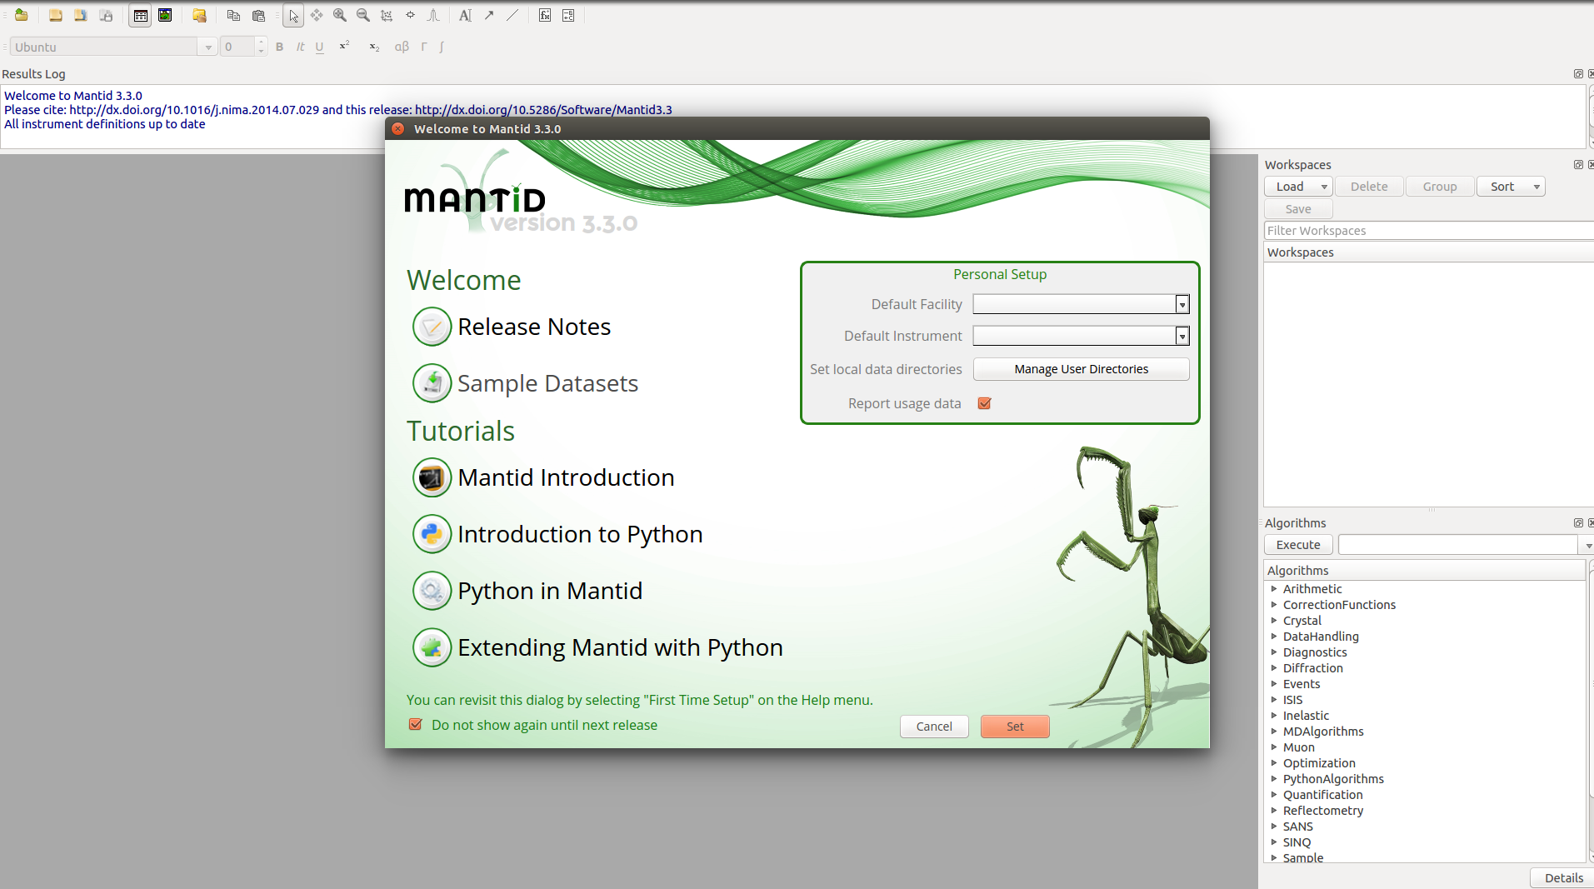

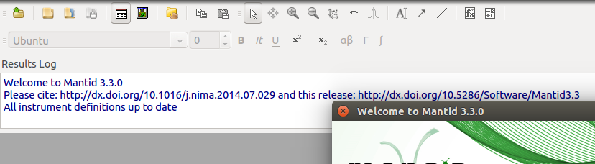
Instrument Definition Repository

Slide 25
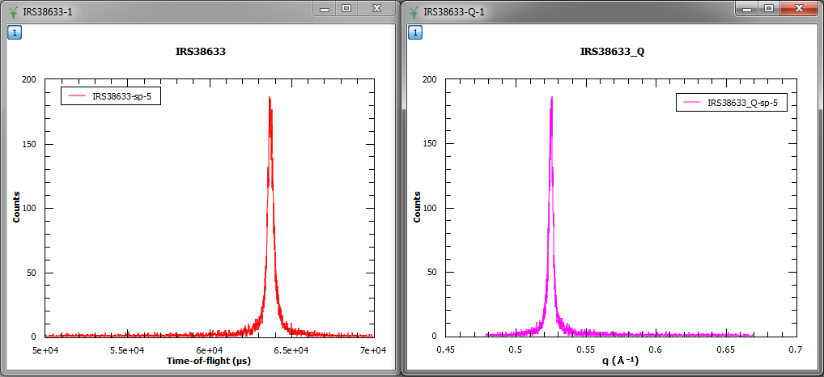
User Interface - Plotting
Auto-generated labels can use more standard labels, e.g. Greek symbols, sub/superscripts

Slide 26
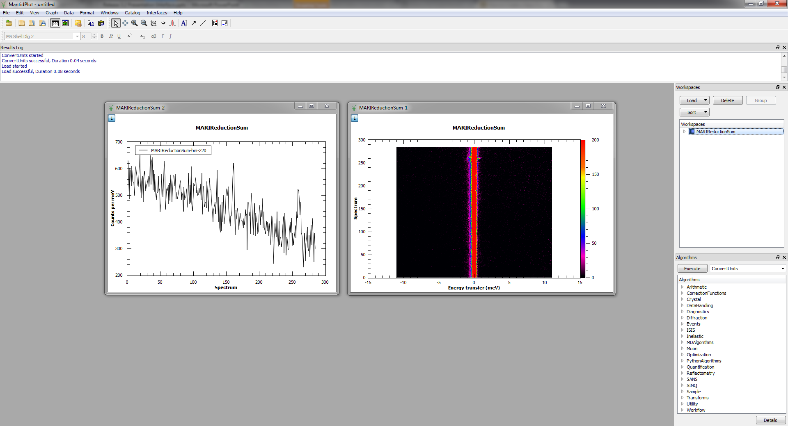
User Interface - Plotting
Bin/colour-fill plots not longer require a table

Slide 27
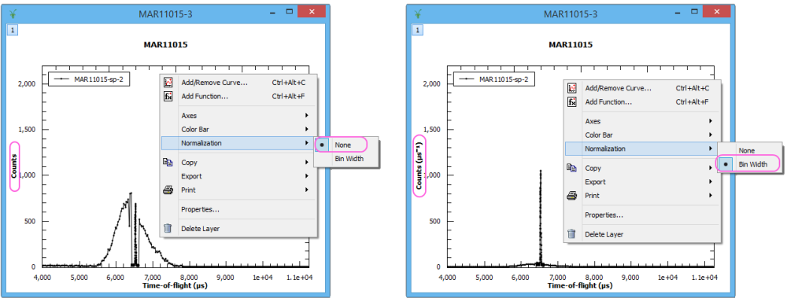
Histogram Plots
Histogram plots are now normalised to bin width by default
Data is not altered

Slide 28
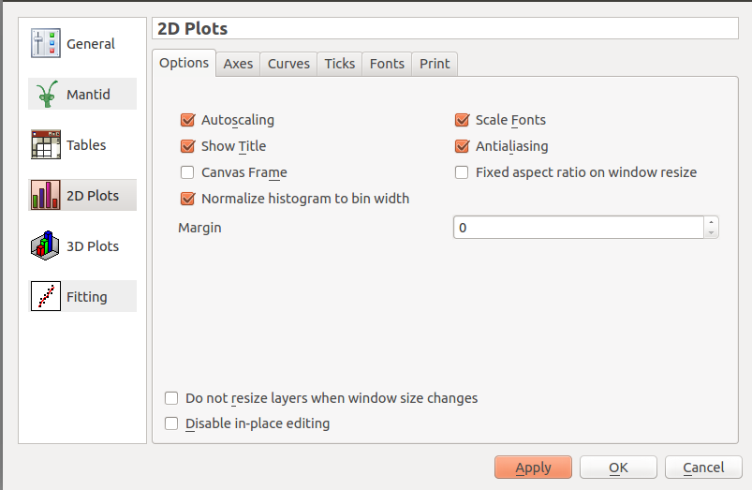
Histogram Plots
Histogram plots are now normalised to bin width by default

Slide 29
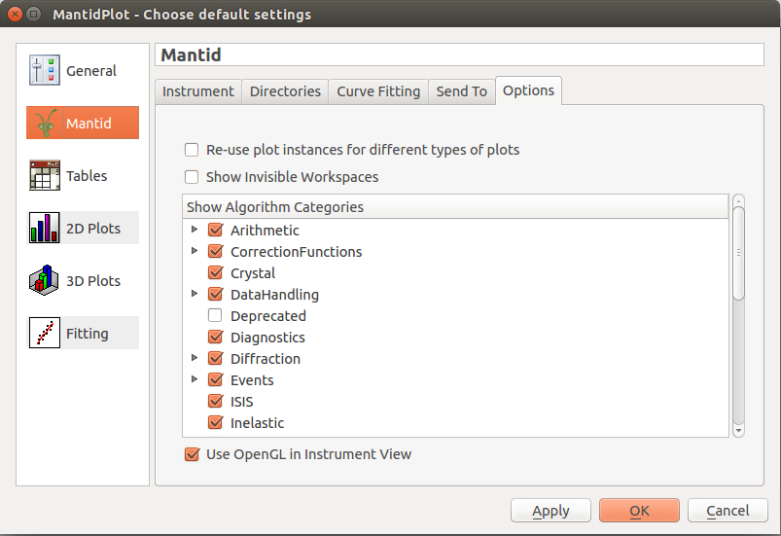
General Plot Options

Slide 30
Planned development starting ~12m
Planning tools
Resolution convolution
Multiple scattering sub project
Parallel algs
Parallel fitting (quantification)
Interface to 3rd party packages
Vates pub. quality plots
CLI improvements
Instrument control implementation

Slide 31
Planned development starting 12-24m
Remote Mantid project
Vates client/server
units

Slide 32
Planned training courses starting 12-24m
VATES
Py-QT
Technique specific i.e. SANS interface
Investigate links to external neutron training schools
In use at ISIS neutron training course

Slide 33
Science specific areas

Slide 34
SANS
Corrections
delQ 6m
Absorption 12m
Model fitting 12m
Others (12-24)

Slide 35
Reflectometry
Unify UIs
SNS complex 12m
ISIS simple 6m
Integrate SNS magnetism into Mantid 12m
Offspec tools sub project 24m

Slide 36
Diffraction
Fix rectangular detector issues 6m
Visible Time-slicing
Easy GUI 12m
Fast logs 12m
Single xtal UX 6m
crystal plan 12m
Unify Instrument calibration 24m

Slide 37
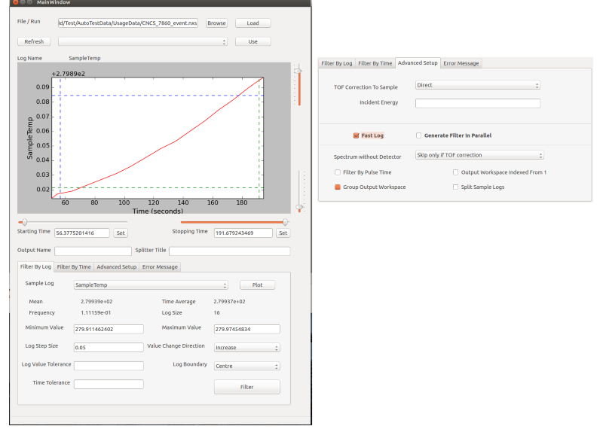
Visual time slicing

Slide 38
Event Filtering with Fast Logs
Fast logging required much higher precision around the filtering
When the sample environment state switches rapidly, the TOF of the neutrons must be taken into account, not just the pulse times for filtering purposes
Generation of the filters has been separated from the application of the filters in algorithmic terms
Used for Reflectometry and Elastic Diffraction at ISIS in limited capacity
Diagnostic Algorithms
RebinByTimeAtSample
RebinByPulseTime

Slide 39
INS
Mslice interface 6m
Planning tools 12m
Compare model to data 12m
Vates improvements to UX 6m
Include different resolution models 6m
TAS 24m

Slide 40
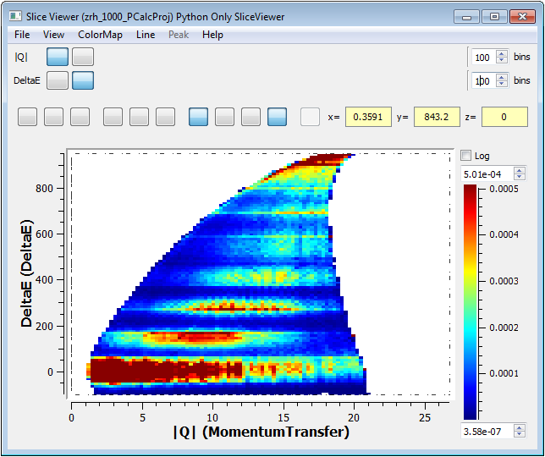
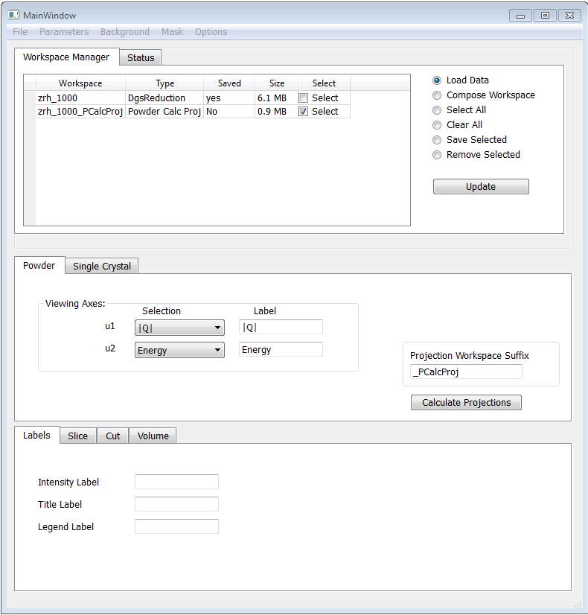
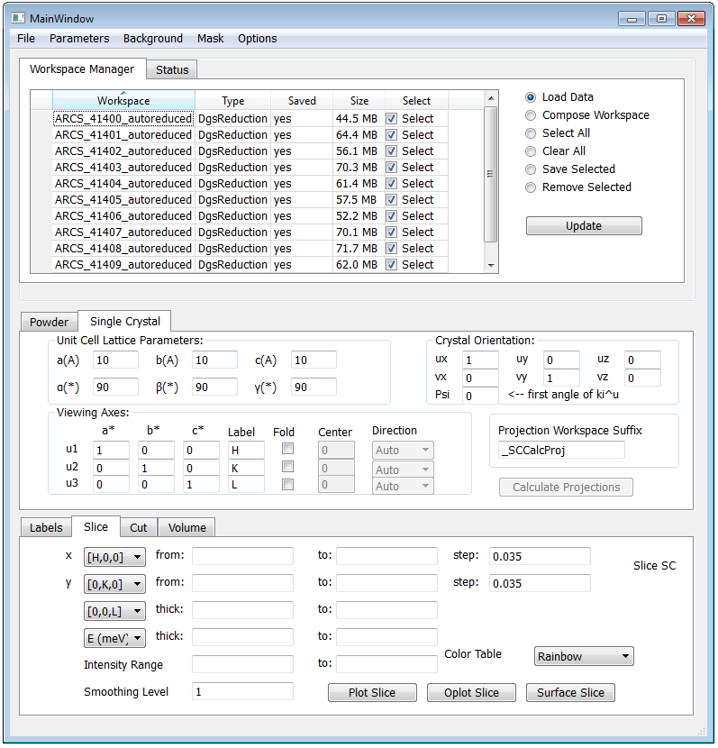
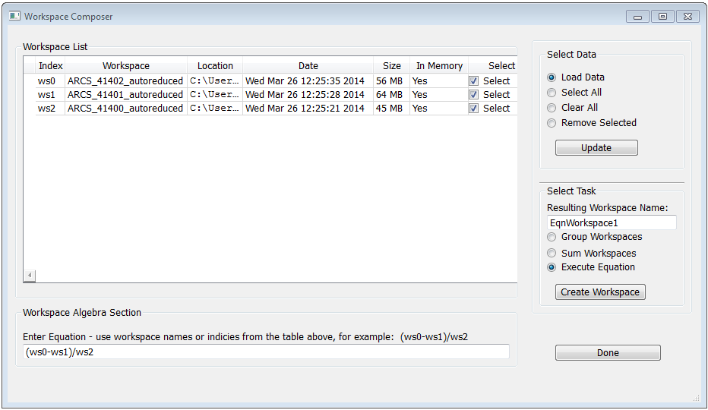
mSlice for Mantid

Slide 41
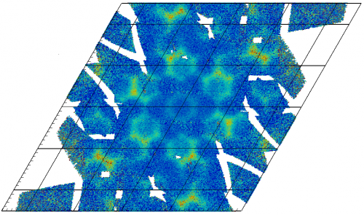
Normalisation
New Normalisation framework
Correctly accounts for statistical weights
MDNormSCD for elastic SC diffraction
Performance enhancements

Slide 42
Unexpected
Imaging and IMAT
Live Data
Adara packet changes
ISIS Live Data rate
Fixed problems with streaming ISIS event data
Now handles multi-period data
Paraview version changes
MD workspace create rate issues
The rise of Autoreduction

Slide 43
Outstanding Requirements
Improving support for instruments
Engin-X, GEM, Larmor, Vesuvio, Muons, reflectometry
Autoreduction
expand use at ISIS
ICAT
uploading data
implementation for SNS
cross facility queries
Live data
include log data (ISIS)

Slide 44
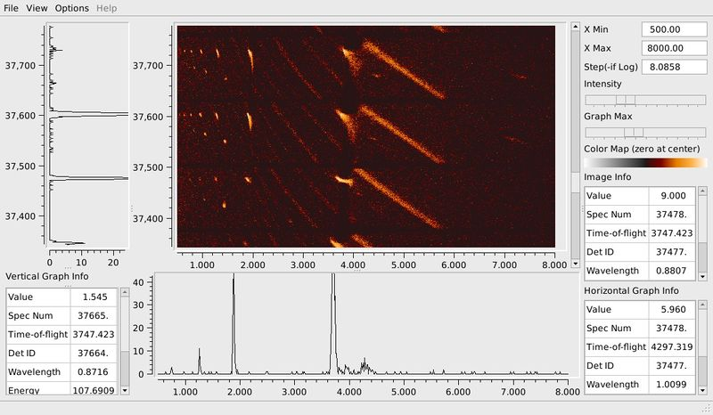
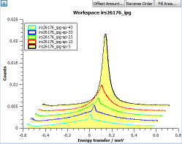
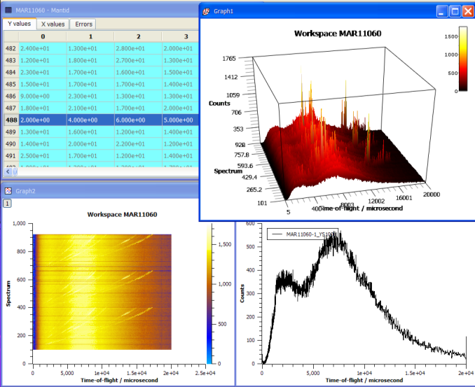
Our Graphs

Slide 45
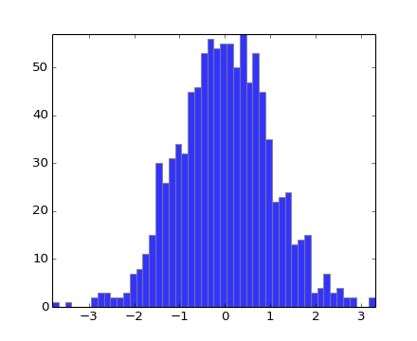
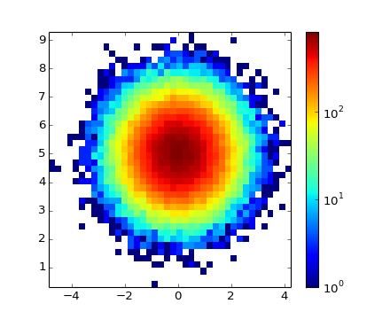
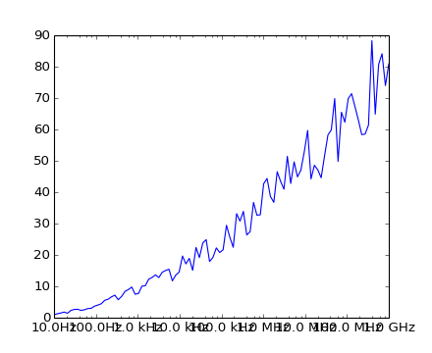
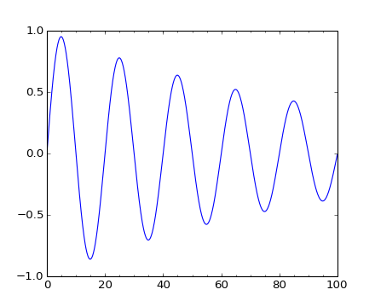
MatplotLib Graphs

